Slide 1
Language Translator
Area - Volume Finder
IT007 – Meetkumar Bhanderi
IT008 – Jaykumar Bhingaradia

Slide 2
Description
The language formulated is for finding area and volume of shapes. Area : Square , Rectangle , Circle , Triangle
Volume : Cube , Slab , Cone , Sphere
Input is given in 2 datatypes : Integer or Float.
If there is more than one inputs in String, then all inputs are in either in Integer or Float.
Don’t use mix input. eg 1 input in Integer and 1 in Float.
Output is displayed in Float.
for lex and yacc we have used flex and bison tools.

Slide 3
modA.l
%{
#include<stdio.h>
#include "y.tab.h"
%}
%%
[0-9]+ {
yylval.integer=atoi(yytext);
return NUMBER;
}
[0-9]*\.[0-9]+ {
yylval.real=(float)atof(yytext);
return FLOAT;
}
find {return find;}
area {return area;}
volume {return volume;}
of {return of;}
circle {return circle;}
square {return square;}

Slide 4
triangle {return triangle;}
rectangle {return rectangle;}
cube {return cube;}
slab {return slab;}
cone {return cone;}
sphere {return sphere;}
having {return having;}
radius {return radius;}
length {return length;}
width {return width;}
and {return and;}
hight {return hight;}
[\n] {return yytext;}
[/t] ;
%%
int yywrap(){return 1;}

Slide 5
modA.y
%{
#include<stdio.h>
#include<math.h>
extern FILE *yyin;
#define PI 3.14
#define CONST 0.5
%}
%union{
int integer;
float real;
}
%token <integer> NUMBER <real> FLOAT
%token find area volume of circle square rectangle triangle cube slab cone sphere having radius length width and hight
%type <real> S E A V
%%
S: find E {$$=$2;};
E: area of A {$$=$3;}
|volume of V {$$=$3;}
;

Slide 6
A: circle having radius NUMBER {$$=PI*$4*$4;printf("Area of circle having radius %d is %f\n",$4,$$);}
|circle having radius FLOAT {$$=PI*$4*$4;printf("Area of circle having radius %f is %f\n",$4,$$);}
|square having length NUMBER {$$=$4*$4;printf("Area of square having length %d is %f\n",$4,$$);}
|square having length FLOAT {$$=$4*$4;printf("Area of square having length %f is %f\n",$4,$$);}
|rectangle having length NUMBER and width NUMBER {$$=$4*$7;printf("Area of square having length %d and width %d is %f\n",$4,$7,$$);}
|rectangle having length FLOAT and width FLOAT {$$=$4*$7;printf("Area of square having length %f and width %f is %f\n",$4,$7,$$);}
|triangle having length NUMBER and hight NUMBER {$$=CONST*$4*$7;printf("Area of triangle having length %d and hight %d is %f\n",$4,$7,$$);}
|triangle having length FLOAT and hight FLOAT {$$=CONST*$4*$7;printf("Area of triangle having length %f and hight %f is %f\n",$4,$7,$$);}
;
V: cube having length NUMBER {$$=$4*$4*$4;printf("Volume of cube having length %d is %f\n",$4,$$);}
|cube having length FLOAT {$$=$4*$4*$4;printf("Volume of cube having length %f is %f\n",$4,$$);}
|slab having length NUMBER and width NUMBER and hight NUMBER {$$=$4*$7*$10;printf("Volume of slab having length %d width %d hight %d is %f\n",$4,$7,$10,$$);}
|slab having length FLOAT and width FLOAT and hight FLOAT {$$=$4*$7*$10;printf("Volume of slab having length %f width %f hight %f is %f\n",$4,$7,$10,$$);}
|cone having radius NUMBER and hight NUMBER {$$=(PI*$4*$4*$7)/3;printf("Volume of cone having radius %d hight %d is %f\n",$4,$7,$$);}
|cone having radius FLOAT and hight FLOAT {$$=(PI*$4*$4*$7)/3;printf("Volume of cone having radius %f hight %f is %f\n",$4,$7,$$);}
|sphere having radius NUMBER {$$=(4*PI*$4*$4*$4)/3;printf("Volume of sphere having radius %d is %f\n",$4,$$);}
|sphere having radius FLOAT {$$=(4*PI*$4*$4*$4)/3;printf("Volume of sphere having radius %f is %f\n",$4,$$);}
;
%%

Slide 7
void yyerror(char *s){}
int main(int argc, char *argv[])
{
yyin=fopen(argv[1],"r");
int i;
for(i=1;i<=7;i++){
yyparse();
}
fclose(yyin);
return 0;
}

Slide 8
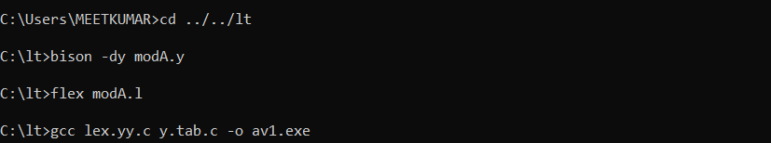
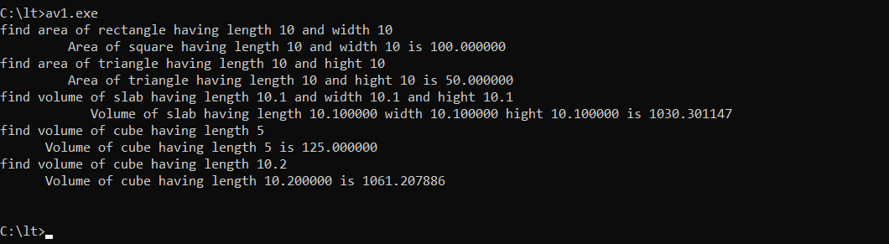
Steps to Compile
Output (inputs in terminal)

Slide 9
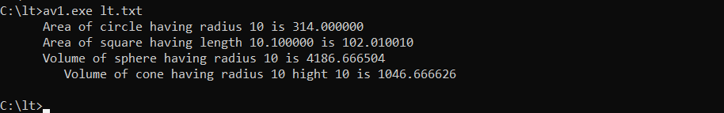
Output (inputs from text file)
lt.txt
find area of circle having radius 10
find area of square having length 10.10
find volume of sphere having radius 10
find volume of cone having radius 10 and hight 10

Slide 10
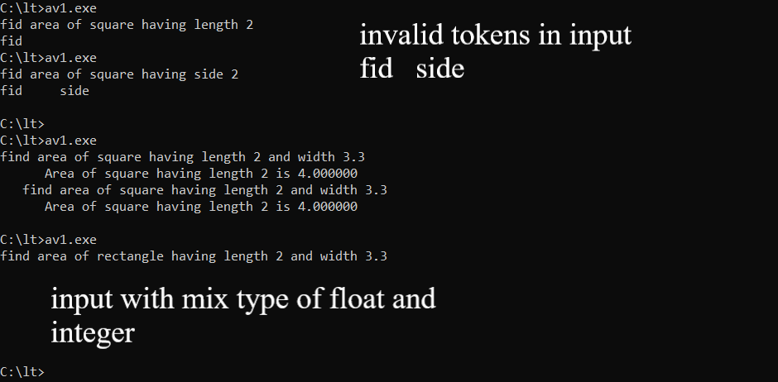
Output for invalid inputs

